Slide 1
CHAPTER 22
Transactions & Serializability

Slide 2
Chapter 22 - Objectives
Function and importance of transactions.
Properties of transactions.
Concurrency Control
Meaning of serializability.
How locking can ensure serializability.
Deadlock and how it can be resolved.
How timestamping can ensure serializability.
Granularity of locking.
‹#›

Slide 3
What is a Transaction?
‹#›

Slide 4
Transaction Support
Transaction
Action, or series of actions, carried out by user or application, which reads or updates contents of database.
Logical unit of work on the database.
Application program is series of transactions with non-database processing in between.
Transforms database from one consistent state to another, although consistency may be violated during transaction.
‹#›

Slide 5
Transaction Support
Can have one of two outcomes:
Success - transaction commits and database reaches a new consistent state.
Failure - transaction aborts, and database must be restored to consistent state before it started.
Such a transaction is rolled back or undone.
Committed transaction cannot be aborted.
Aborted transaction that is rolled back can be restarted later.
‹#›

Slide 6
Properties of Transactions
‹#›

Slide 7
Properties of Transactions
Four basic (ACID) properties that define a transaction are:
Atomicity : ‘All or nothing’ property.
Consistency : Must transform database from one consistent state to another.
Isolation : Partial effects of incomplete transactions should not be visible to other transactions.
Durability : Effects of a committed transaction are permanent and must not be lost because of later failure.
‹#›

Slide 8
How can the DB guarantee these properties when multiple transactions are running???
‹#›

Slide 9
Solution1: Serial Schedule
Simplest way to support transaction semantics is to require that each transaction runs to completion before the next one begins
A serial schedule is a schedule where operations of each transaction are executed consecutively without any interleaved operations from other transactions (each transaction commits before the next one is allowed to begin)
This is not a solution for the real world
Cannot overlap I/O operations and computation
Multiple cores or processors are sitting idle
Workload may just be really heavy
Response time gets longer
Short transactions must wait for long ones to finish
‹#›

Slide 10
Solution2: Concurrency
Create a schedule that has the same results as a serial schedule.
A schedule is a sequence of the operations by a set of concurrent transactions that preserves the order of operations in each of the individual transactions
Any schedule that corresponds to a serial schedule is correct. So define schedules that interleave operations from different transactions such that the final database result corresponds with the results of running the transactions serially.
Goal: determine when can we interleave the operations from different transactions?
‹#›

Slide 11
Which transactions are safe to run at the same time and which are not?
‹#›

Slide 12
Concurrency Control
Transactions that are safe to run at the same time :
Two transaction that only perform read operations will not conflict.
Two transactions that are reading or writing different objects will not conflict
There may be interference that can result in inconsistencies when:
The two transactions are accessing the same data object, and
one transaction writes a data item and another transaction reads or writes that same data item.
‹#›

Slide 13
Concurrency Control
Process of managing simultaneous operations on the database without having them interfere with one another.
Prevents interference when two or more users are accessing database simultaneously and at least one is updating data.
Although two transactions may be correct in themselves, interleaving of operations may produce an incorrect result.
‹#›

Slide 14
Need for Concurrency Control
Examples of potential problems caused by concurrency:
Lost update problem.
Uncommitted dependency problem (Dirty Read).
Inconsistent analysis problem (Nonrepeatable Read).
‹#›

Slide 15
Lost Update Problem
Lost updates occur when two or more transactions select the same row and then update the row based on the value originally selected.
Each transaction is unaware of other transactions.
The last update overwrites updates made by the other transactions, which results in lost data.
For example, two editors make an electronic copy of the same document.
Each editor changes the copy independently and then saves the changed copy, thereby overwriting the original document.
The editor who saves the changed copy last overwrites changes made by the first editor.
‹#›

Slide 16
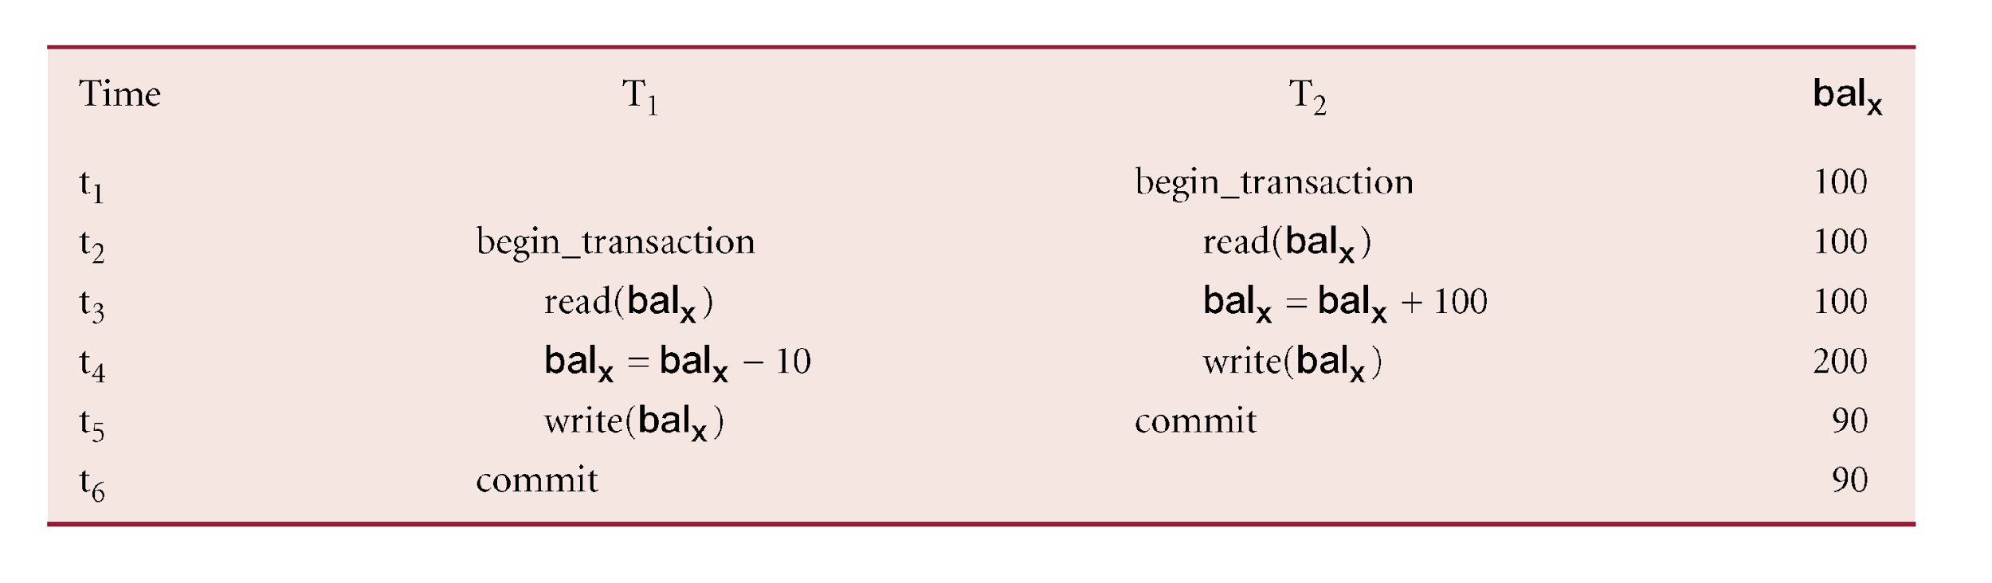
Lost Update Problem
‹#›

Slide 17
Lost Update Problem
Successfully completed update is overridden by another user.
T₁ withdrawing £10 from an account with bal_{x}, initially £100.
T₂ depositing £100 into same account.
Serially, final balance would be £190.
Loss of T₂’s update can be avoided by preventing T₁ from reading bal_{x} until after update.
‹#›

Slide 18
Uncommitted Dependency Problem
Uncommitted dependency (or the dirty read problem)
First transaction updates a data object
the second transaction reads that updated value BEFORE the first transaction commits
⇒ so 2nd transaction has access to uncommitted data
For example, an editor is making changes to an electronic document. During the changes, a second editor takes a copy of the document that includes all the changes made so far, and distributes the document to the intended audience. The first editor then decides the changes made so far are wrong and removes the edits and saves the document. The distributed document contains edits that no longer exist, and should be treated as if they never existed.
‹#›

Slide 19
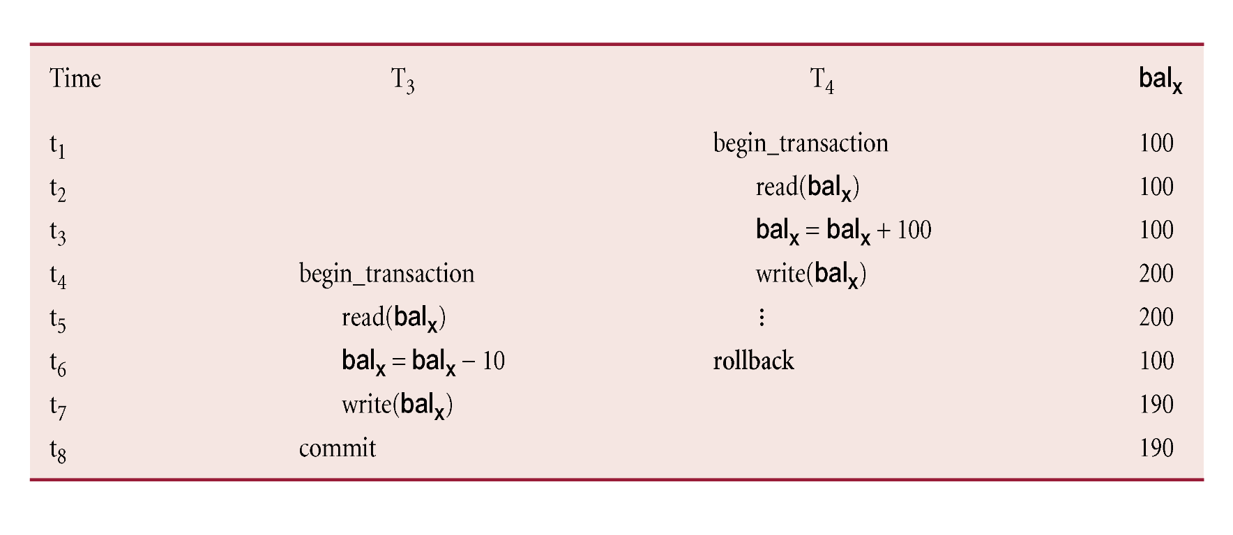
Uncommitted Dependency Problem
‹#›

Slide 20
Uncommitted Dependency Problem
Occurs when one transaction can see intermediate results of another transaction before it has committed.
T₄ updates bal_{x} to £200 but it aborts, so bal_{x} should be back at original value of £100.
T₃ has read new value of bal_{x} (£200) and uses value as basis of £10 reduction, giving a new balance of £190, instead of £90.
Problem avoided by preventing T₃ from reading bal_{x} until after T₄ commits or aborts.
‹#›

Slide 21
Inconsistent Analysis Problem
Inconsistent analysis (or unrepeatable read problem):
First transaction reads a data object
The second transaction updates the values while the first transaction is still processing the data
example: a transaction that is summing a column in a table will get inaccurate results if another transaction is inserting or updating records in that table.
Inconsistent analysis is similar to uncommitted dependency in that another transaction is changing the data that a second transaction is reading
In inconsistent analysis, the data read by the second transaction was committed by the transaction that made the change.
Inconsistent analysis involves multiple reads (two or more) of the same row and each time the information is changed by another transaction
‹#›

Slide 22
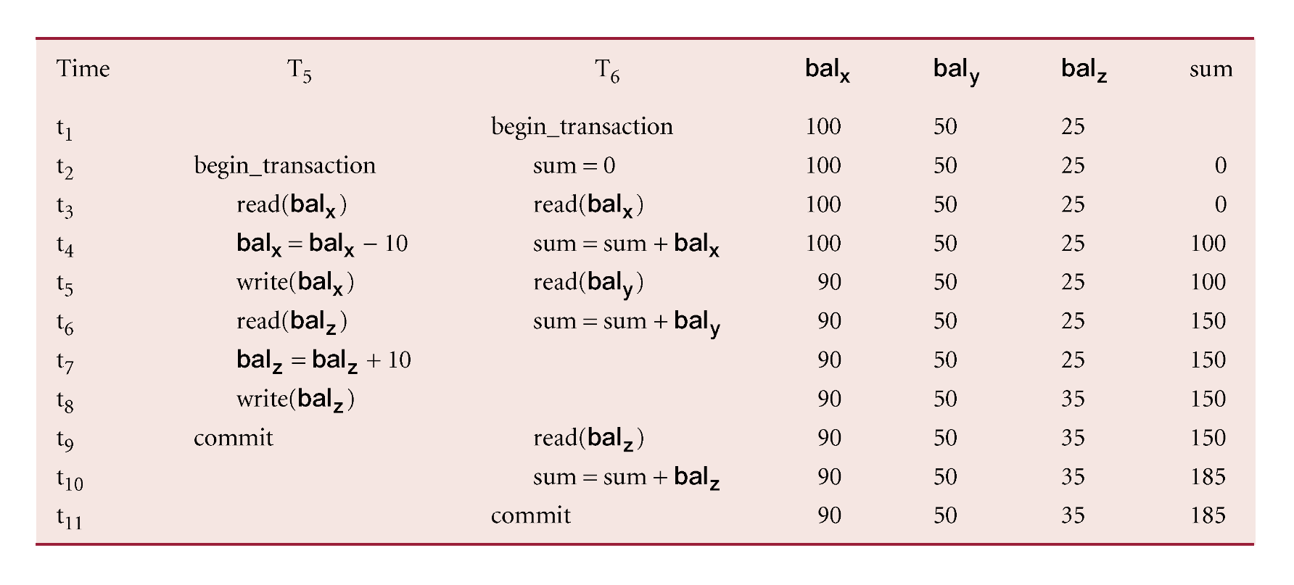
Inconsistent Analysis Problem
‹#›

Slide 23
Inconsistent Analysis Problem
Occurs when transaction reads several values but second transaction updates some of them during execution of first.
T₆ is totaling balances of account x (£100), account y (£50), and account z (£25).
Meantime, T₅ has transferred £10 from bal_{x} to bal_{z}, so T₆ now has wrong result (£10 too high).
Problem avoided by preventing T₆ from reading bal_{x} and bal_{z} until after T₅ completed updates.
‹#›

Slide 24
Serializability
‹#›

Slide 25
Serializability
Schedule
Sequence of reads/writes by set of concurrent transactions.
Serial Schedule
Schedule where operations of each transaction are executed consecutively without any interleaved operations from other transactions.
Objective of a concurrency control protocol is to schedule transactions in such a way as to avoid any interference.
Could run transactions serially, but this limits degree of concurrency or parallelism in system.
Serializability identifies those executions of transactions guaranteed to ensure consistency.
‹#›

Slide 26
Nonserial Schedule
Schedule where operations from set of concurrent transactions are interleaved.
Objective of serializability is to find non-serial schedules that allow transactions to execute concurrently without interfering with one another.
Schedule is called serializable if
non-serial schedules equivalent to some serial schedule
‹#›

Slide 27
Serializability
In serializability, ordering of read/writes is important:
(a) If two transactions only read a data item, they do not conflict and order is not important.
(b) If two transactions either read or write separate data items, they do not conflict and order is not important.
(c) If one transaction writes a data item and another reads or writes same data item, order of execution is important.
‹#›

Slide 28
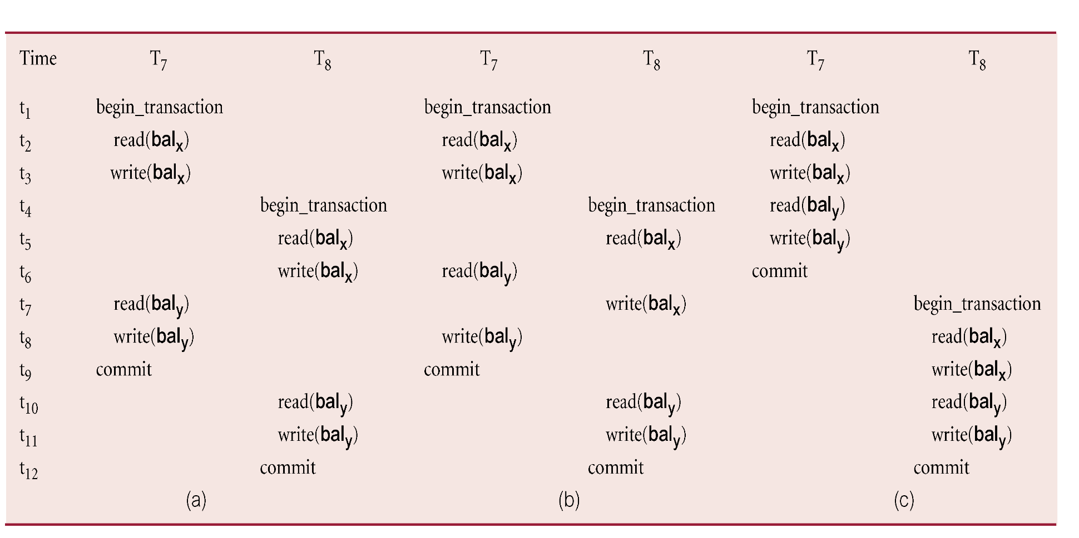
Example of Serializability
‹#›

Slide 29
Serializability
A schedule is conflict serializable if transactions in the schedule have a conflict but the schedule is still serializable
Under constrained write rule (transaction updates data item based on its old value, which is first read)
how to determine whether a schedule is conflict serializable?
==> use precedence graph to test for conflict serializability.
‹#›

Slide 30
Precedence Graph
Create:
node for each transaction;
a directed edge T_{i} → T_{j}, if T_{j} reads the value of an item written by T_{I};
a directed edge T_{i} → T_{j}, if T_{j} writes a value into an item after it has been read by T_{i}.
If precedence graph contains cycle schedule is not conflict serializable.
‹#›

Slide 31
Example - Non-conflict serializable schedule
T₉ is transferring £100 from one account with balance bal_{x} to another account with balance bal_{y}.
T₁₀ is increasing balance of these two accounts by 10%.
Precedence graph has a cycle and so is not serializable.
‹#›

Slide 32
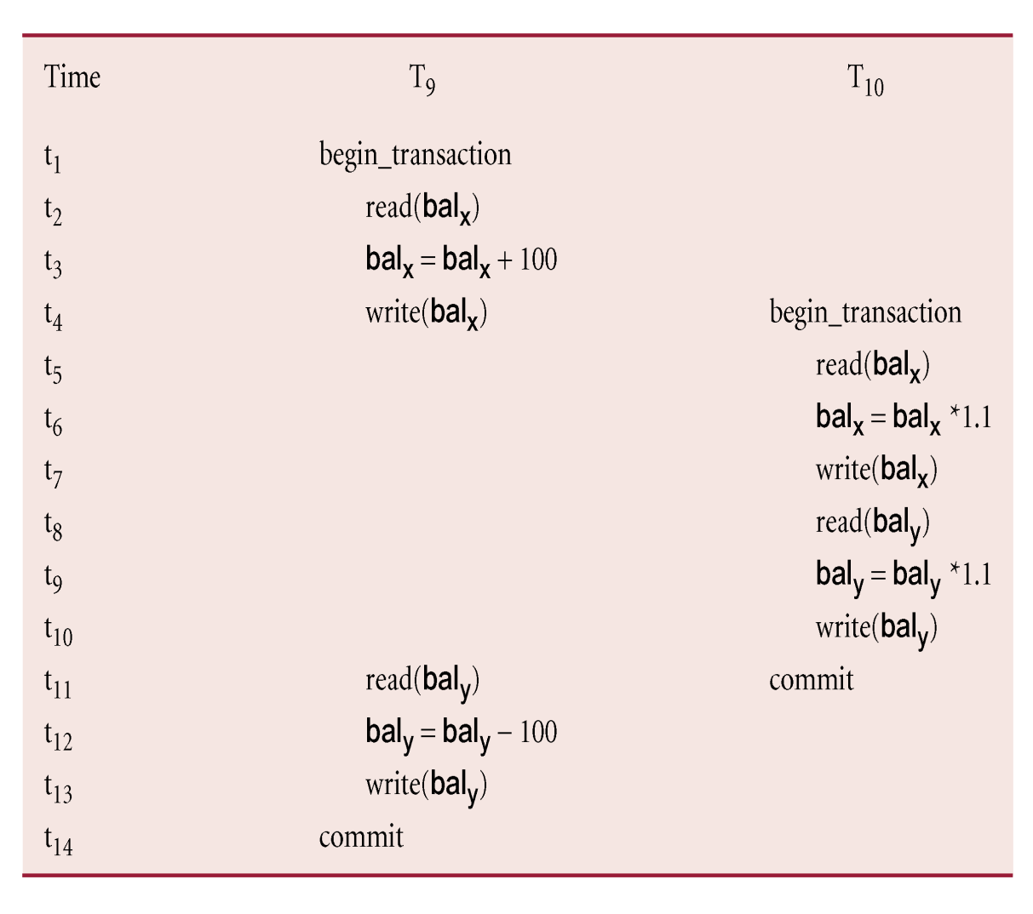
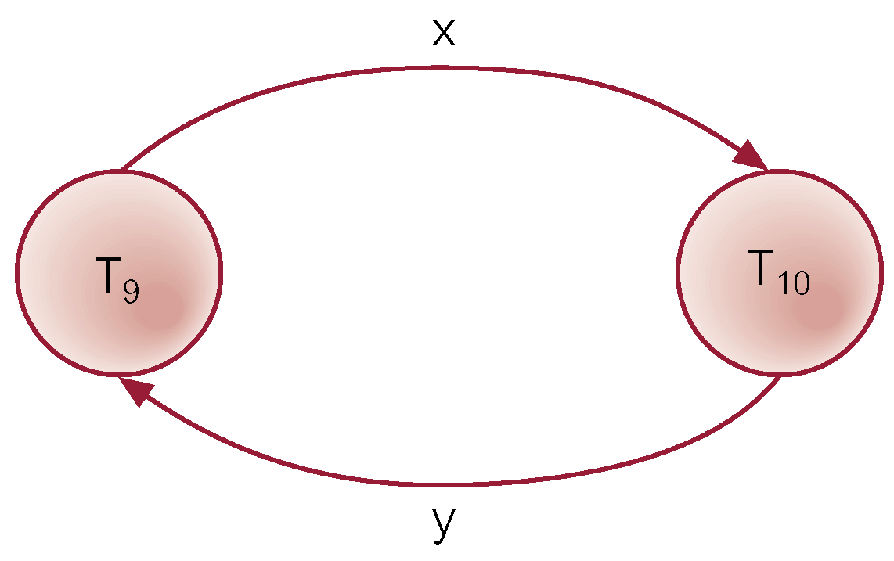
Example - Non-conflict serializable schedule
‹#›

Slide 33
Concurrency Control Techniques
‹#›

Slide 34
Concurrency Control Techniques
Two basic concurrency control techniques:
Locking,
Timestamping.
Both are conservative approaches: delay transactions in case they conflict with other transactions.
‹#›

Slide 35
Locking
Transaction uses locks to deny access to other transactions and so prevent incorrect updates.
Most widely used approach to ensure serializability.
Two types of locks:
shared (read) lock - prevents any transaction from modifying the resource
exclusive (write) lock - prevents other transactions from modifying this resource or even reading it.
‹#›

Slide 36
Locking - Basic Rules
A transaction with shared lock on item, can read but not update item.
A transaction with exclusive lock on item, can both read and update item.
Reads cannot conflict, so more than one transaction can hold shared locks simultaneously on same item.
Exclusive lock gives transaction exclusive access to that item.
‹#›

Slide 37
Example - Incorrect Locking Schedule
For two transactions above, a valid schedule using these rules is:
S = {write_lock(T₉, bal_{x}), read(T₉, bal_{x}), write(T₉, bal_{x}), unlock(T₉, bal_{x}), write_lock(T₁₀, bal_{x}), read(T₁₀, bal_{x}), write(T₁₀, bal_{x}), unlock(T₁₀, bal_{x}), write_lock(T₁₀, bal_{y}), read(T₁₀, bal_{y}), write(T₁₀, bal_{y}), unlock(T₁₀, bal_{y}), commit(T₁₀), write_lock(T₉, bal_{y}), read(T₉, bal_{y}), write(T₉, bal_{y}), unlock(T₉, bal_{y}), commit(T₉) }
‹#›

Slide 38
Example - Incorrect Locking Schedule
If at start, bal_{x} = 100, bal_{y} = 400, result should be:
bal_{x} = 220, bal_{y} = 330, if T₉ executes before T₁₀, or
bal_{x} = 210, bal_{y} = 340, if T₁₀ executes before T₉.
However, result gives bal_{x} = 220 & bal_{y} = 340.
S is not a serializable schedule.
WHY NOT ?
‹#›

Slide 39
Example - Incorrect Locking Schedule
Problem - transactions release locks too soon, resulting in loss of total isolation and atomicity.
To guarantee serializability, need an additional protocol concerning the positioning of lock and unlock operations in every transaction.
‹#›

Slide 40
Two-Phase Locking (2PL)
Transaction follows 2PL protocol if all locking operations precede first unlock operation in the transaction.
Two phases for transaction:
Growing phase - acquires all locks but cannot release any locks.
Shrinking phase - releases locks but cannot acquire any new locks.
‹#›

Slide 41
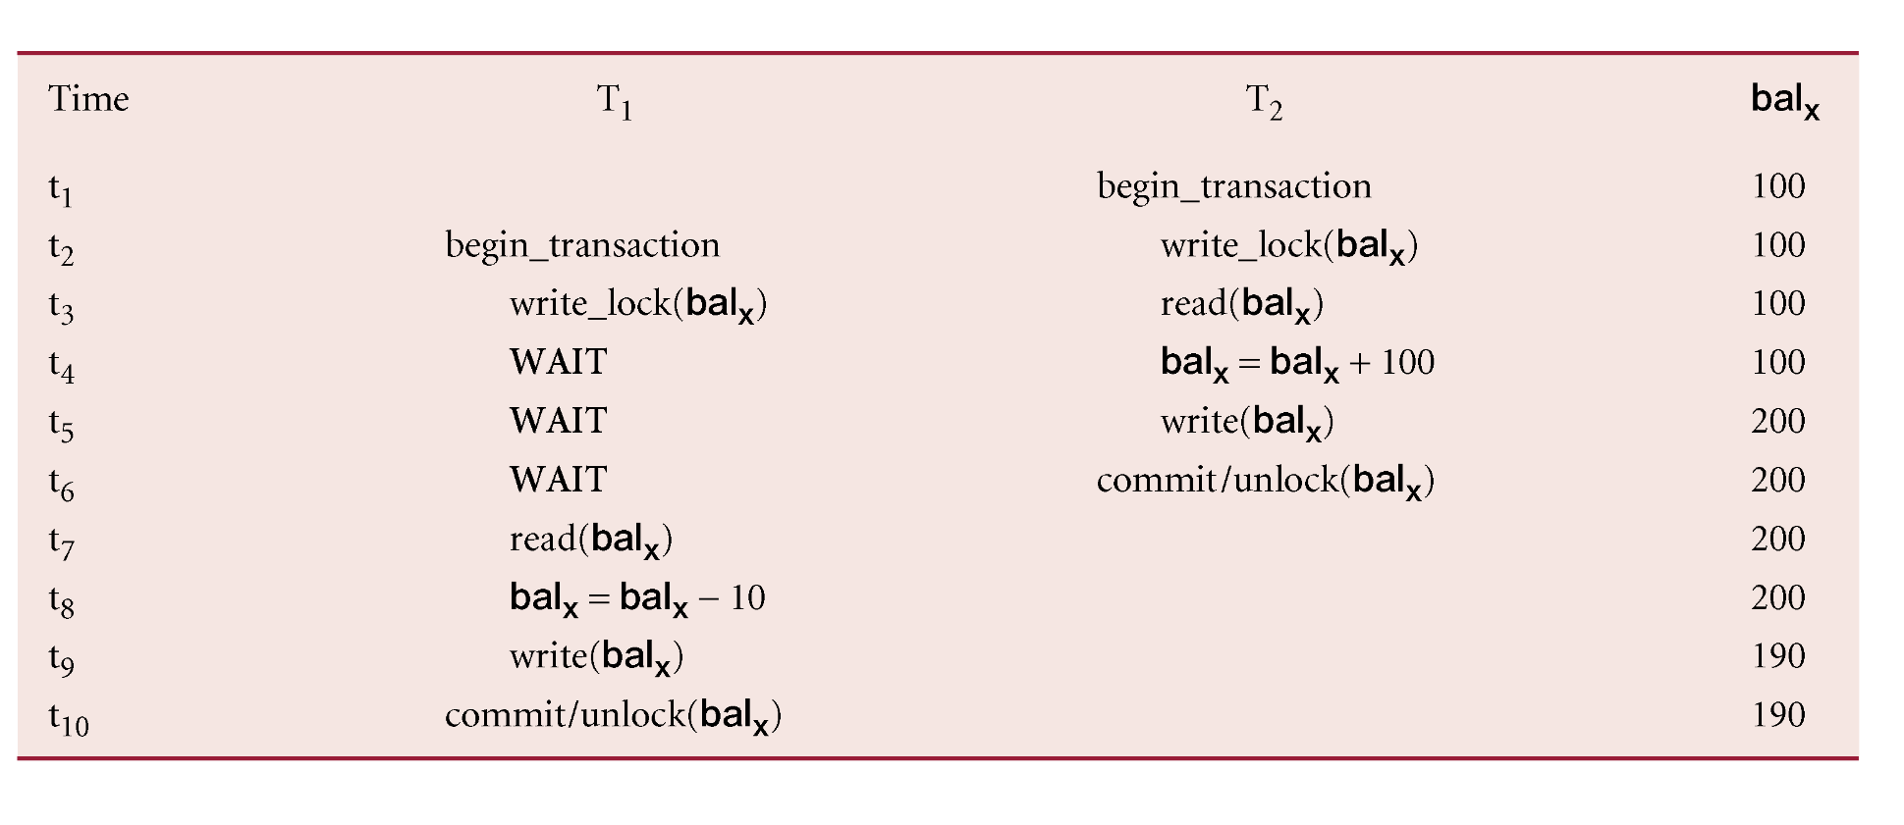
Preventing Lost Update Problem using 2PL
‹#›

Slide 42
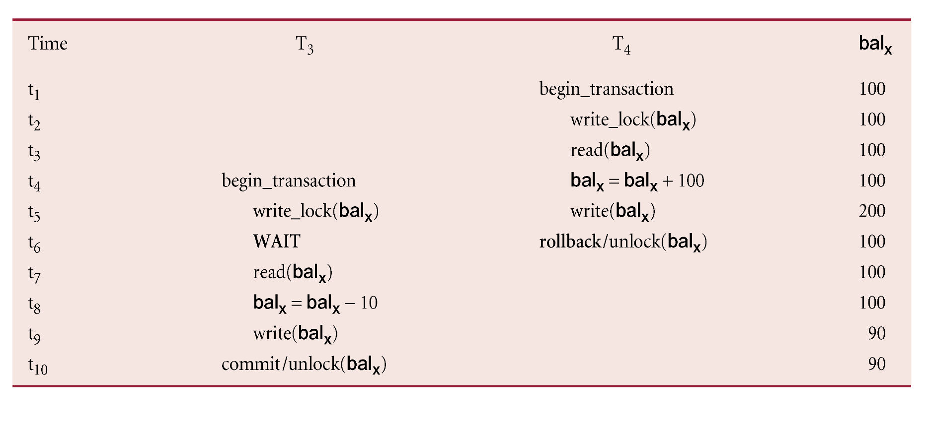
Preventing Uncommitted Dependency Problem using 2PL
‹#›

Slide 43
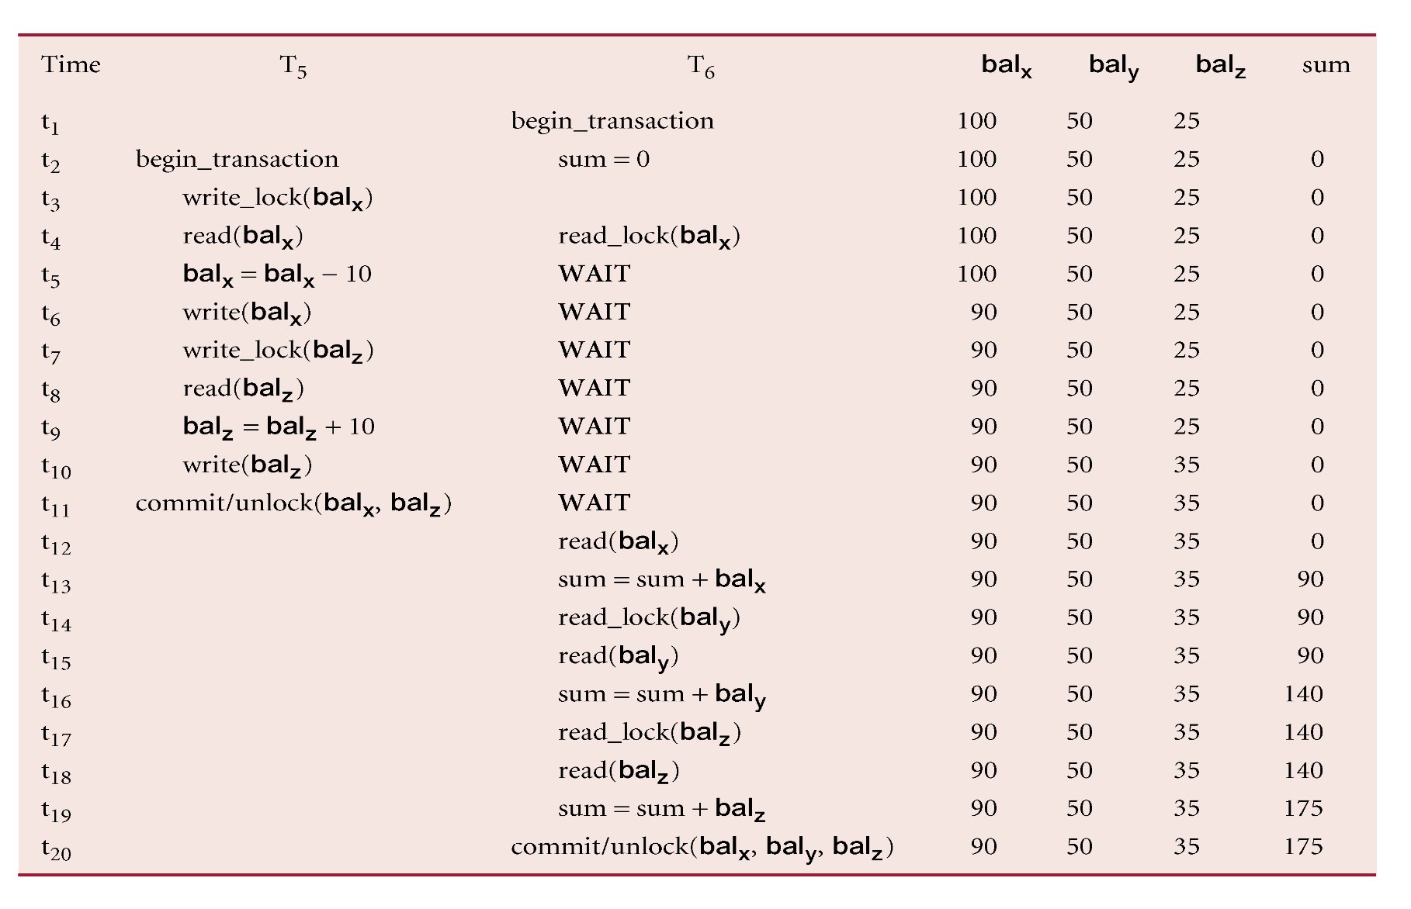
Preventing Inconsistent Analysis Problem using 2PL
‹#›

Slide 44
Cascading Rollback
If every transaction in a schedule follows 2PL, schedule is serializable.
However, problems can occur with interpretation of when locks can be released.
‹#›

Slide 45
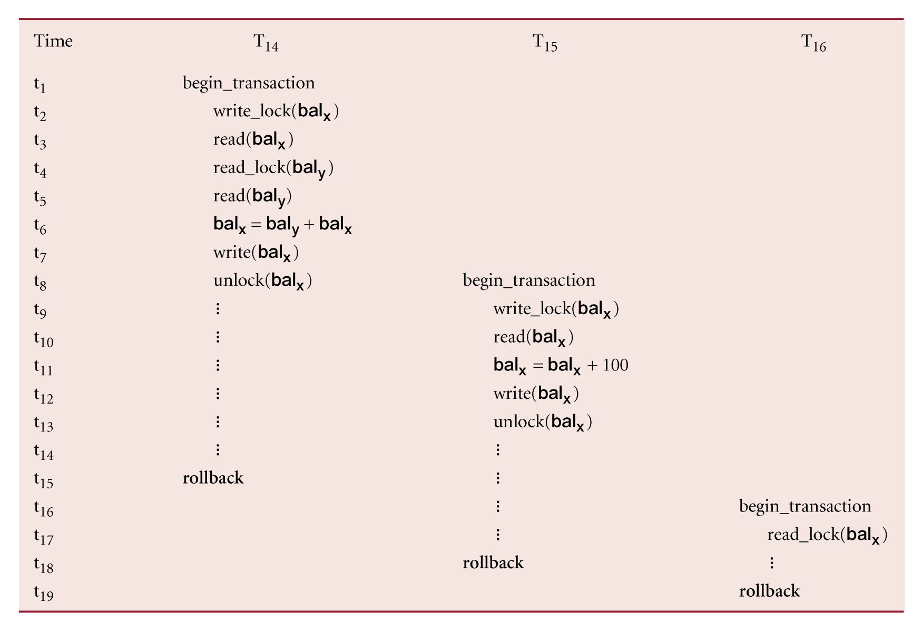
Cascading Rollback
‹#›

Slide 46
Cascading Rollback
Transactions conform to 2PL.
T₁₄ aborts.
Since T₁₅ is dependent on T₁₄, T₁₅ must also be rolled back. Since T₁₆ is dependent on T₁₅, it too must be rolled back.
This is called cascading rollback.
To prevent this with 2PL, leave release of all locks until end of transaction.
‹#›

Slide 47
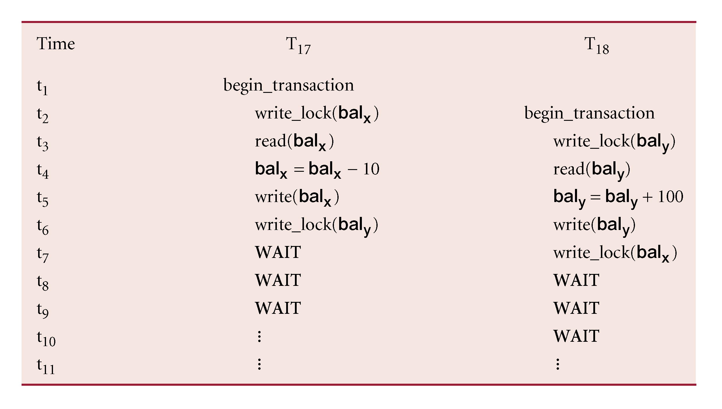
Deadlock
An impasse that may result when two (or more) transactions are each waiting for locks held by the other to be released.
‹#›

Slide 48
Deadlock
Only one way to break deadlock: abort one or more of the transactions.
Deadlock should be transparent to user, so DBMS should restart transaction(s).
‹#›

Slide 49
Deadlock
Three general techniques for handling deadlock:
Timeouts.
Deadlock prevention.
Deadlock detection and recovery.
‹#›

Slide 50
Timeouts
Transaction that requests lock will only wait for a system-defined period of time.
If lock has not been granted within this period, lock request times out.
In this case, DBMS assumes transaction may be deadlocked, even though it may not be, and it aborts and automatically restarts the transaction.
‹#›

Slide 51
Deadlock Prevention
DBMS looks ahead to see if transaction would cause deadlock and never allows deadlock to occur.
Could order transactions using transaction timestamps:
Wait-Die - only an older transaction can wait for younger one, otherwise transaction is aborted (dies) and restarted with same timestamp.
Wound-Wait - only a younger transaction can wait for an older one. If older transaction requests lock held by younger one, younger one is aborted (wounded).
‹#›

Slide 52
Deadlock Detection and Recovery
DBMS allows deadlock to occur but recognizes it and breaks it.
Usually handled by construction of wait-for graph (WFG) showing transaction dependencies:
Create a node for each transaction.
Create edge T_{i} -> T_{j}, if T_{i} waiting to lock item locked by T_{j}.
Deadlock exists if and only if WFG contains cycle.
WFG is created at regular intervals.
‹#›

Slide 53
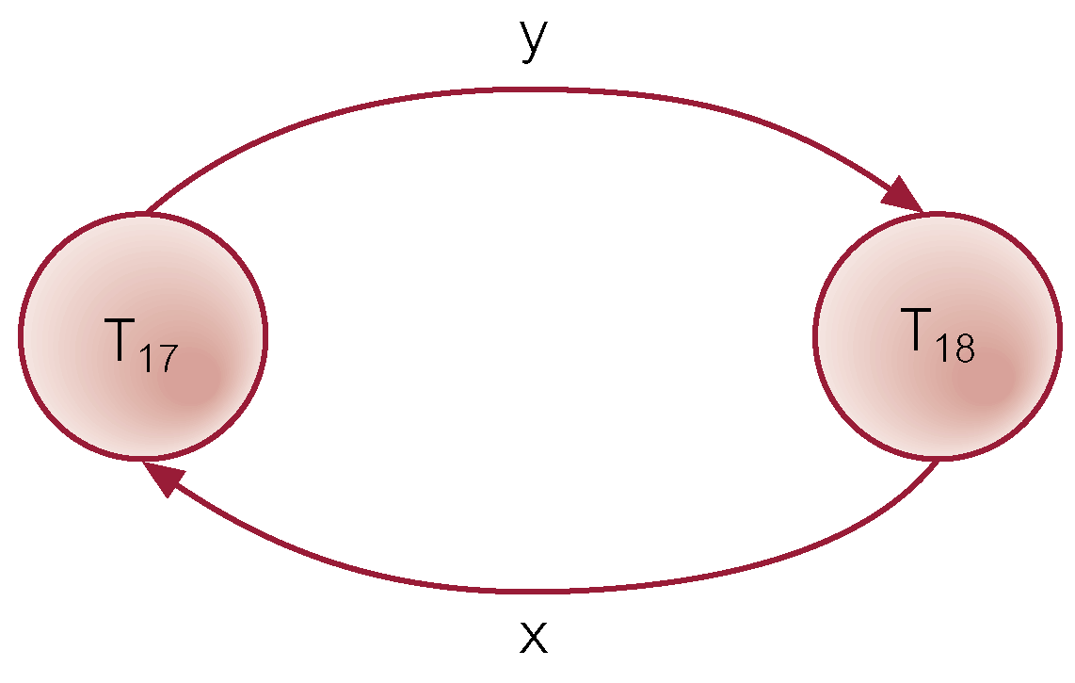
Example - Wait-For-Graph (WFG)
‹#›

Slide 54
Recovery from Deadlock Detection
Several issues:
choice of deadlock victim;
how far to roll a transaction back;
avoiding starvation.
‹#›

